Slide 1
Health Economics
Chapter 5: Health Production

Slide 2
Production Function of Health
HS
f(health care, lifestyle, environment, genetics)
Health care
In the graph, we are holding lifestyle, environment, and genetics constant as we vary health care. Changes in these variables shift the curve up and down.

Slide 3
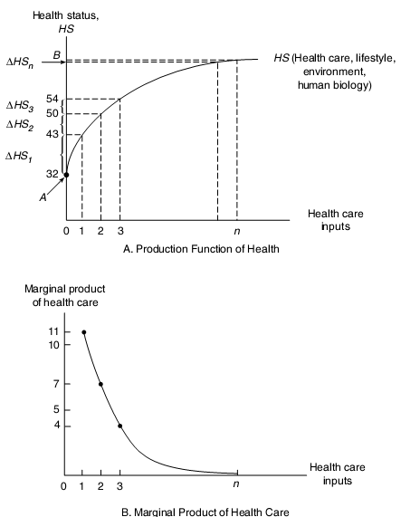
Decreasing Marginal Product

Slide 4
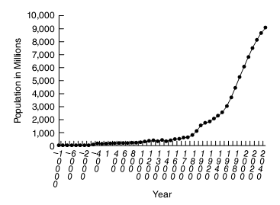
World Population

Slide 5
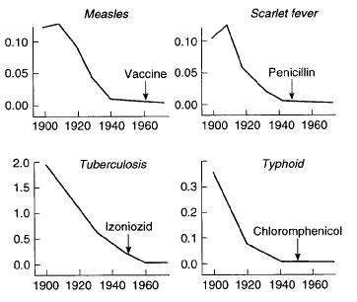
Fall in Death Rates Happened Prior to Introduction of “Modern” Health Care

Slide 6
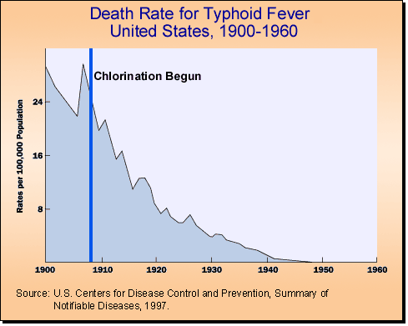
“It’s Sanitation”

Slide 7
Bureau of Community Health Services Projects

Slide 8
Infant Mortality Rate: List by the United Nations Population Division (2008)
Rank Country Infant mortality rate (deaths/1,000 live births)
1 Angola 182.31
2 Sierra Leone 156.48
3 Afghanistan 154.67
4 Liberia 143.89
5 Niger 115.42
163 United States 6.3
174 United Kingdom 4.8
180 Austria 4.4
182 Germany 4.3
218 Iceland 3.25
219 Hong Kong 2.93
220 Japan 2.80
221 Sweden 2.75
222 Singapore 2.30

